Slide 1

Road Sign Classification Using CNN Model
Name : V Dhanasekaran
Course : Data Analytics & Data Science
Batch : April 2025

Slide 2
Problem Statement
To Classify Road Signs Automatically Using A Deep Learning Model.
Improve Safety And Assist Autonomous Driving Systems.
Build A Full Ml Pipeline Using CNN: Preprocessing → Training → Evaluation → UI.
Handle 43 Classes Of Diverse Traffic Signs.

Slide 3
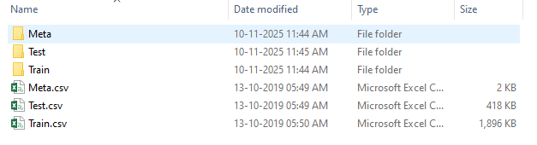
.
Dataset Overview
Dataset contains 43 road sign classes.
Train: 33,337 images, Validation: 5,872, Test: 12,630.
Images are of varying sizes and conditions.
Labels provided through folder structure + Test.csv file

Slide 4
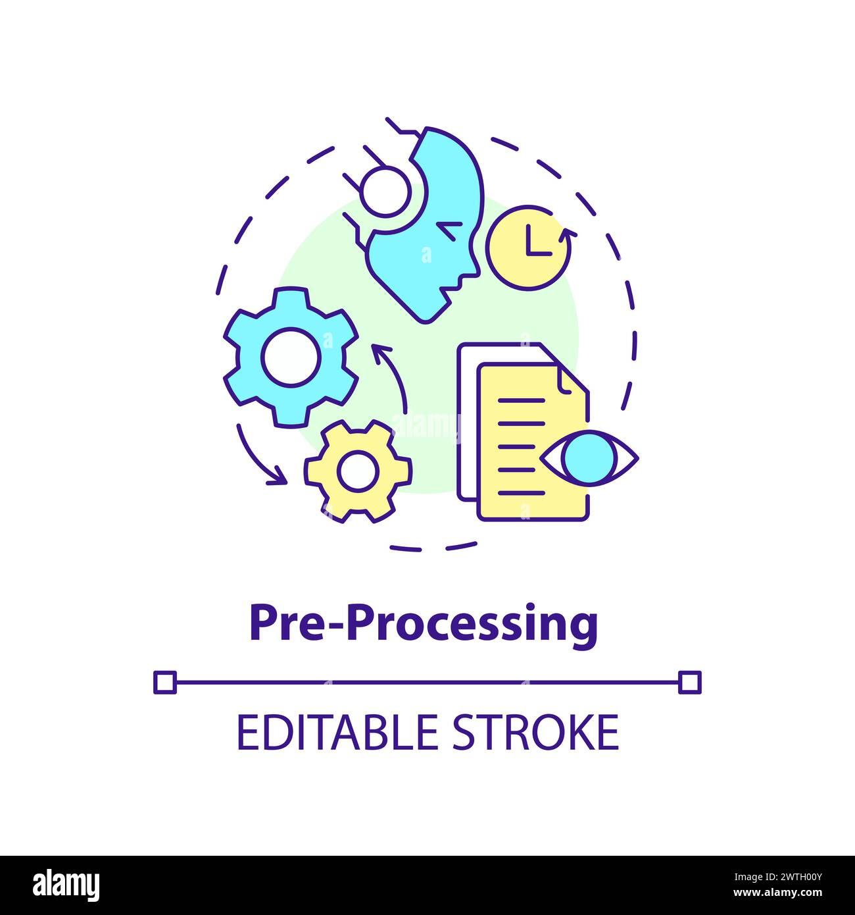
Data Pre-processing
Resized All Images To 64 × 64 For Uniform Input Shape.
Normalized Pixel Values Between 0 And 1.
Fixed Incorrect Image Paths From Test.Csv Before Loading.
Prepared Generators For Efficient Batch Loading.

Slide 5
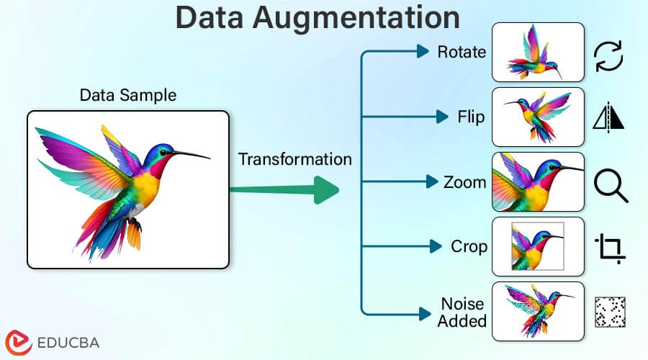
Data Augmentation
Applied Rotation, Zoom, Shifting, And Flipping.
Increased Dataset Variability To Avoid Overfitting.
Strengthened Model’s Ability To Generalize.
Augmentation Applied Only To Training Data.

Slide 6
.
CNN Architecture
Convolutional Layer
Pooling Layer
Flatten Layer
Connected Layer
Output Layer
Three blocks of Conv2D + Batch Norm + Max Pooling layers.
Flatten → Dense (256 units) → Dropout for classification.
Sofmax output layer for 43-class classification.
Model complexity: ~1.28 million parameters

Slide 7
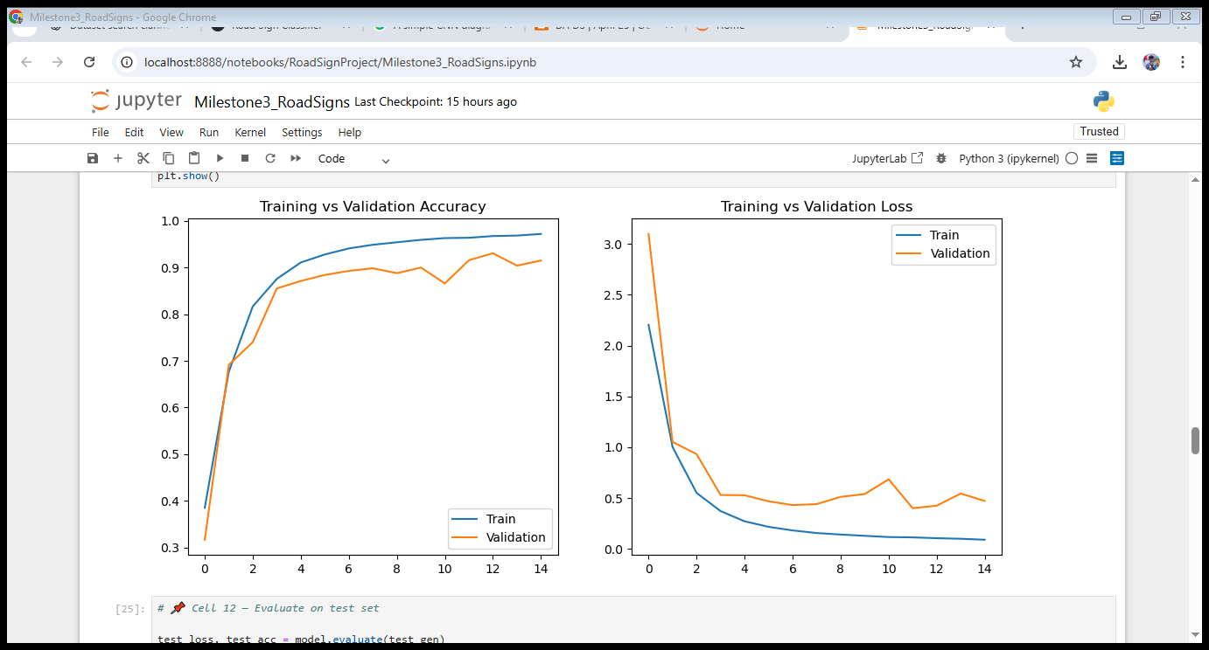
Model Training
Trained For 15 Epochs Using The Adam Optimizer.
Loss Function: Categorical Cross entropy.
Monitored Accuracy & Loss For Train/Validation Sets.
Model Converged Smoothly With Strong Learning Pattern.

Slide 8
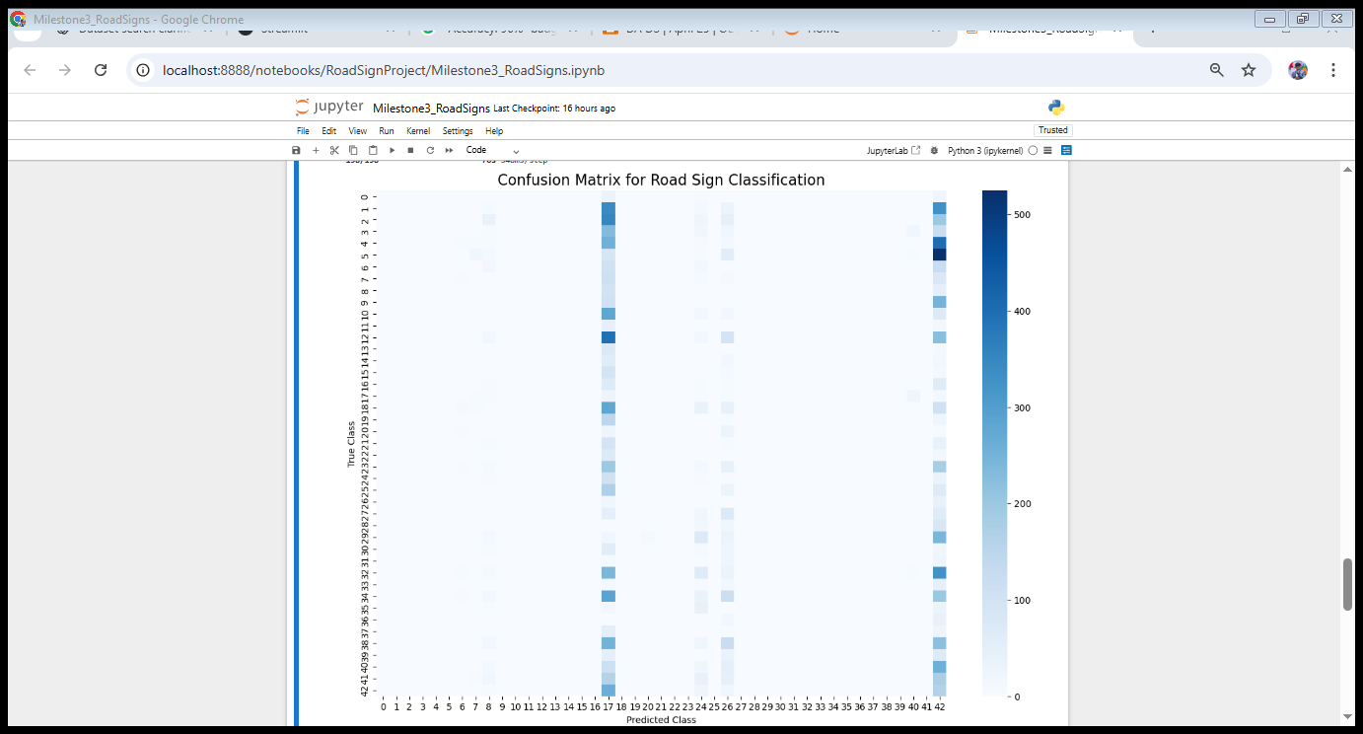
.
Model Evaluation
Achieved ~96% Test Accuracy.
Validation Accuracy Closely Matched Training Accuracy.
Classification Report Generated For All 43 Classes.
Confusion Matrix Used To Analyze Class-wise Performance

Slide 9
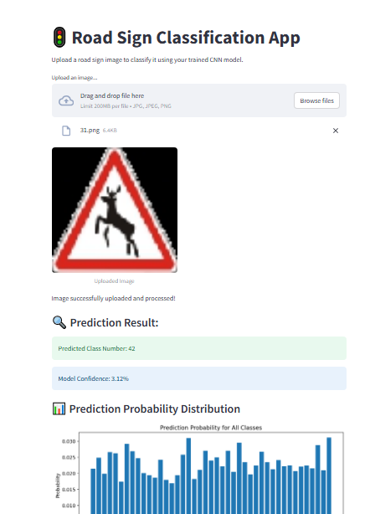
Prediction & Streamlit App
Saved Model As Roadsigns_cnn_model.H5.
Streamlit UI Developed To Upload Road Sign Images.
Outputs Predicted Class Number And Confidence Percentage.
Probability Distribution Shown Using A Bar Chart.

Slide 10

Conclusion & Future Enhancements
Successfully Built An End-to-end Road Sign Classification System.
High Accuracy And Strong Generalization Across All Classes.
Useful For Smart Vehicles And Traffic Monitoring Applications.
Future: Add Class Names, Deploy Online, Real-time Camera Detection, Transfer Learning

